Slide 1

Satellite Collision Risk Predictor
An ML Project by Yash Kumar Srivastava
BCA–IBM 2nd Year, 3rd Semester
Tools: Python, Machine Learning, Streamlit, Scikit-learn

Slide 2
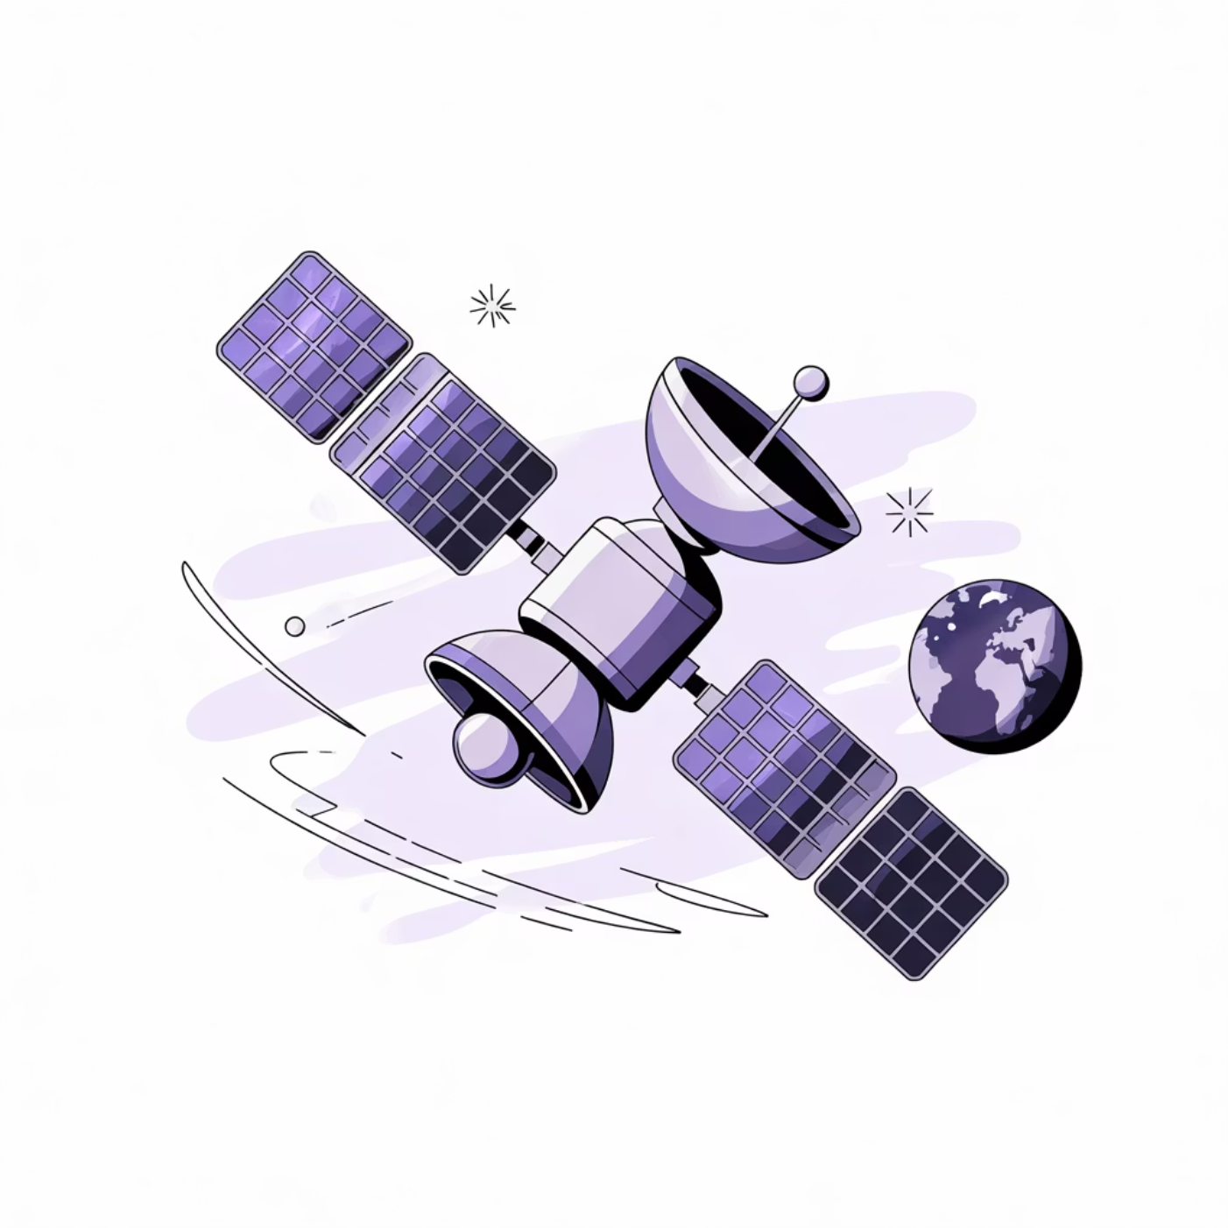
Introduction: A Real Problem in a Growing Space
The ever-growing volume of space debris poses a significant threat to operational satellites, making collision prediction crucial for safeguarding valuable assets in orbit.
Space debris is increasing annually, creating a more hazardous environment.
Satellites face a heightened risk of devastating collisions.
Accurate collision risk prediction can prevent catastrophic damage and loss.
Objective: Develop an ML model to classify satellite approaches as Safe or High Risk.

Slide 3
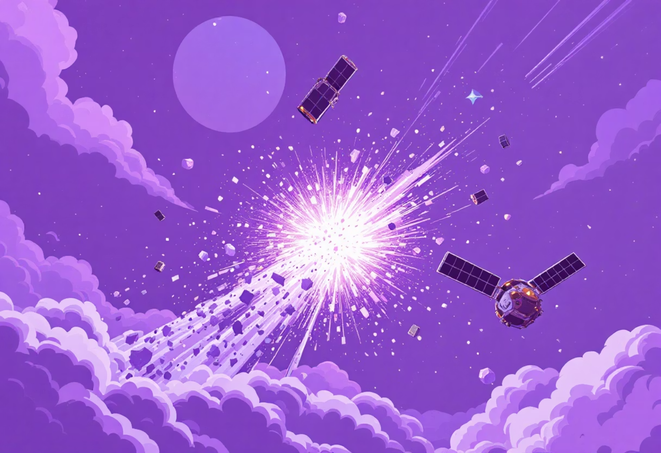
Project Goal: Predict Satellite Collisions Before They Happen
Our goal is to build a smart ML model that tells space agencies: “This looks risky — act now.”
Why is this Prediction Crucial?
Space missions demand immense investment; protection is paramount.
A single collision can lead to widespread orbital disaster, generating more debris.
Empowering operators with rapid, informed decision-making capabilities.

Slide 4

What Our Model Learns From
Our model learns from a carefully curated dataset, translating complex orbital mechanics into structured features for machine learning.
The dataset, comprising 75 entries, captures critical parameters for each satellite approach scenario:
Relative Distance
km
Relative Speed
km/s
Debris Size
cm
Approach Angle
degrees
Debris Type
Metal / Rock / Fragment
Prediction Label:
Risk = 0 (Safe): No immediate threat.
Risk = 1 (High Risk): Potential for collision.

Slide 5




Data Preprocessing: Preparing for Prediction
Rigorous preprocessing transforms raw data into a format suitable for machine learning, ensuring accuracy and model performance.
Encoding Categorical Data
Normalizing Numerical Values
Applied OneHotEncoding to transform the 'Debris Type' into a numerical format, preventing misleading ordinal relationships.
Scaled numerical features to a standard range, ensuring all features contribute equally to the model's learning process.
Handling Missing Values
Train/Test Split
Implemented strategies to address any missing data points, maintaining dataset integrity and preventing model bias.
Divided the dataset into 80% training and 20% testing sets to evaluate model performance on unseen data.
The preprocessor was saved alongside the final model for consistent future predictions.

Slide 6


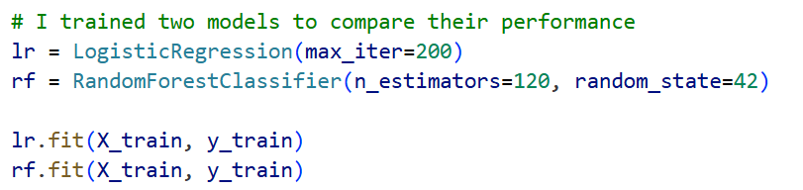
Machine Learning Models
We explored two robust classification algorithms to identify the most effective solution for satellite collision prediction.
Logistic Regression
Random Forest Classifier
A fundamental algorithm for binary classification, providing a baseline for performance.
An ensemble method that builds multiple decision trees, enhancing predictive power and robustness.
Accuracy: 88%
Excels with smaller datasets.
F1 Score: 85%
Highly effective for classification tasks.
Demonstrated superior accuracy.
Accuracy: 96%
F1 Score: 95%

Slide 7

Final Model Selection: Precision in Orbit
Based on comprehensive evaluation, the Random Forest Classifier emerged as the optimal choice for our Satellite Collision Risk Predictor.
1
2
3
Superior Accuracy
Enhanced Generalization
Stable Predictions
Achieved the highest accuracy scores during testing, minimizing false positives and negatives critical for space safety.
Demonstrated robust performance on unseen data, ensuring reliable predictions in dynamic orbital environments.
Provided consistent and dependable risk assessments, vital for operational decision-making.
The chosen model has been serialized and saved as: models/sat_rf_model.pkl for seamless integration and deployment.

Slide 8
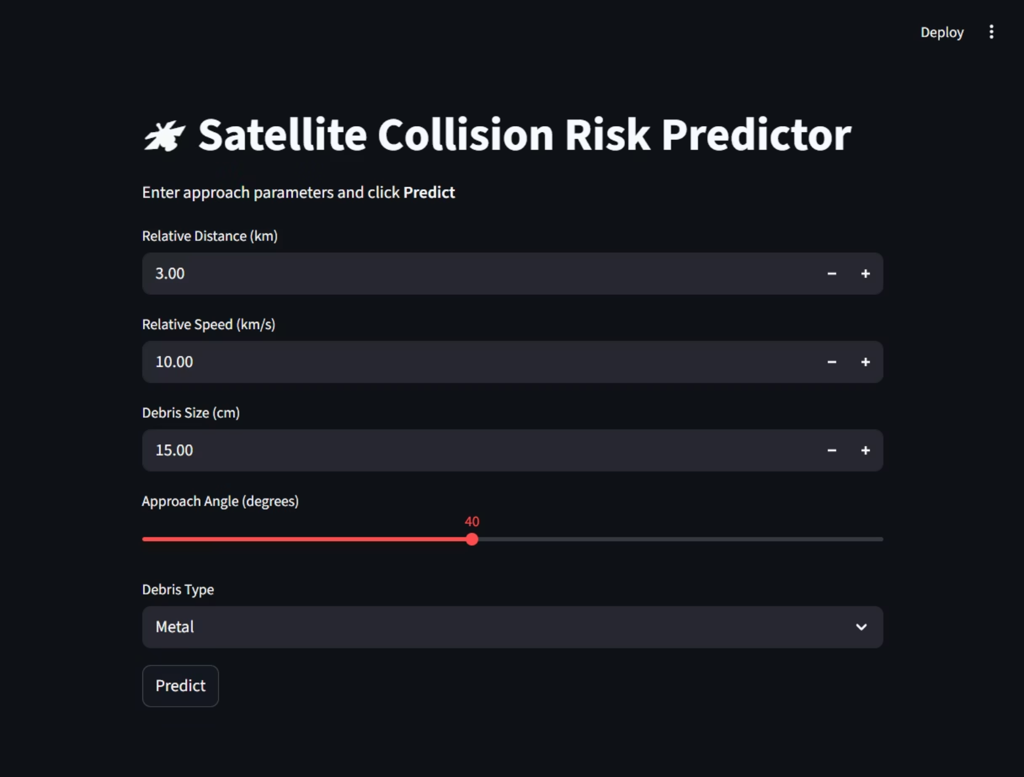
Web Application: Interactive Risk Prediction
Our Streamlit-powered web application provides an intuitive interface for real-time collision risk assessment.
User Input Fields: Allows operators to enter various approach parameters.
Predict Button: Triggers immediate risk analysis by the deployed ML model.
Clear Risk Display: Visually presents the predicted risk level (Safe / High Risk).
Probability Output: Shows the confidence score for the prediction.
Voice Output: Integrates a male voice to announce risk levels, enhancing user experience and critical alerts.

Slide 9
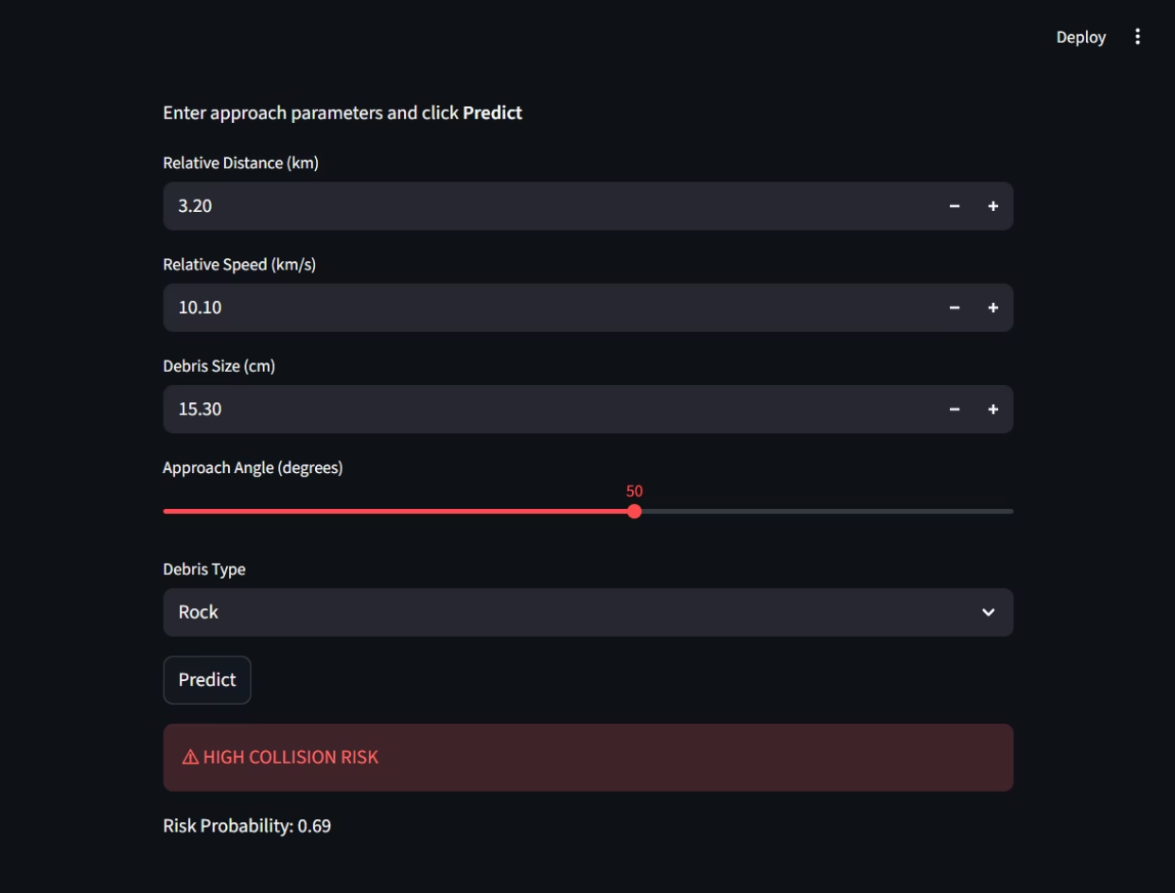
Live Demonstration: Witnessing the Predictor in Action
Experience the Satellite Collision Risk Predictor firsthand, designed for immediate and impactful insights.
Input Parameters: Users enter crucial satellite approach data.
Instant Prediction: Model rapidly classifies the scenario as Safe or High Risk.
Probability Display: A clear percentage indicates the confidence of the prediction.
Auditory Alerts: Voice output provides an immediate, hands-free notification of potential dangers, boosting situational awareness.
This real-time capability empowers space operators to make swift, informed decisions to safeguard valuable orbital assets.

Slide 10
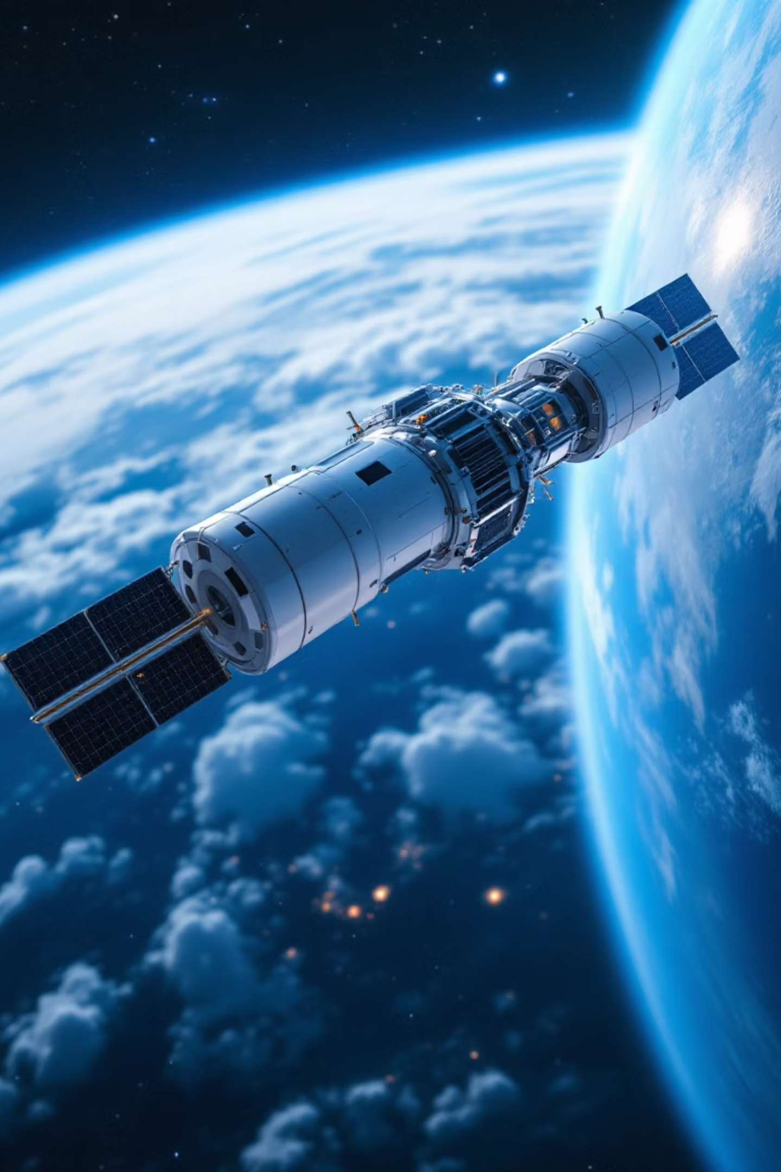
Safer Space, Thanks to ML
This project successfully demonstrates the power of machine learning in addressing critical space safety challenges, delivering a practical tool for satellite collision risk prediction.
ML Model Excellence
Successfully built and trained a Random Forest model achieving 96% accuracy for satellite collision prediction
End-to-End Deployment
Trained, evaluated, saved, and deployed the model through an intuitive Streamlit web application
Practical Integration
Demonstrated seamless ML integration with real-time user interface and voice alert capabilities
Future Potential
Foundation ready for extension to real-world satellite tracking systems and operational deployment
This Satellite Collision Risk Predictor represents a significant step toward safer space operations, combining cutting-edge machine learning with accessible technology to protect our orbital infrastructure.

Slide 11

Future Scope: Expanding the Horizon
The current implementation serves as a strong foundation, with numerous opportunities for enhancement and real-world deployment to maximize impact in space safety operations.
01
02
Real NASA API Integration
Cloud Deployment
Integrate live data from NASA's Conjunction Data Messages (CDM) API for real-time satellite tracking and collision predictions
Deploy the application online using AWS, Google Cloud, or Azure for global accessibility and scalability
03
04
Enhanced Dataset
3D Orbit Visualization
Expand the training dataset with thousands of real orbital scenarios to improve model accuracy and robustness
Add interactive 3D visualization of satellite trajectories and potential collision zones for better situational awareness
05
Multi-Satellite Tracking
Extend capabilities to monitor and predict risks for multiple satellites simultaneously across different orbital planes
These enhancements will transform the predictor from a proof-of-concept into a production-ready system capable of protecting critical space infrastructure.

Slide 12
Thank-you
Presented By: Yash Kumar Srivastava
BCA–IBM, 2nd Year
GitHub: https://github.com/YashKrSriva/IBM-Project-File

